Slide 1
From DNA to proteins:
the case study of SARS-COV-2
Dr Paolo Actis, p.actis@leeds.ac.uk

Slide 2
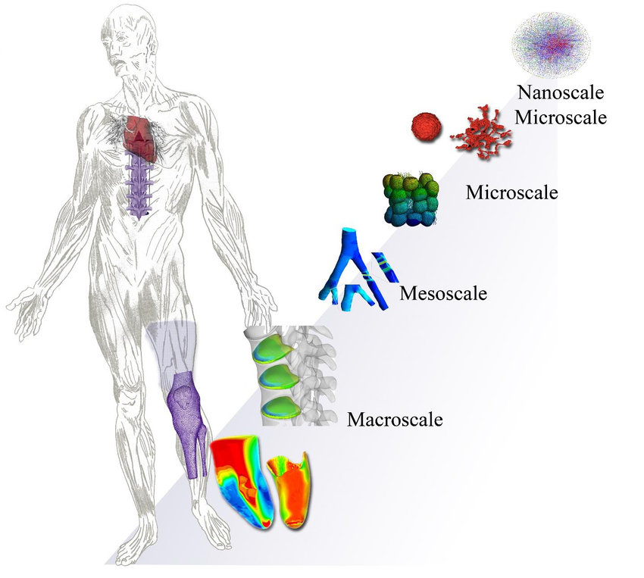
An electronics journey through the human body
Dernowsek et al, 2018, Biomechanics

Slide 3
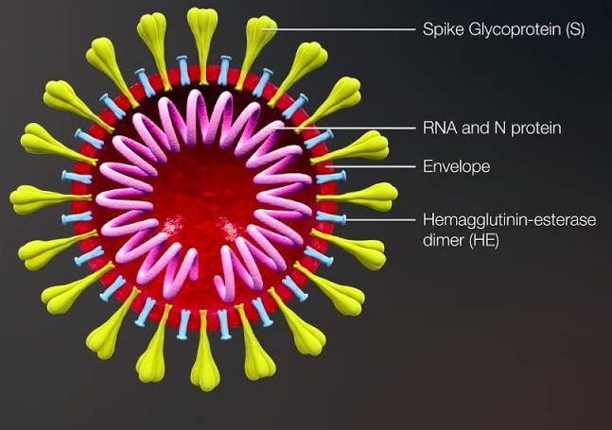

Slide 4
DNA/RNA Nanopore Sequencing

Slide 6
What is an antibody?
Y-shaped protein used by the immune system to neutralize pathogens

Slide 7
What is an antibody?
Y-shaped protein used by the immune system to neutralize pathogens
Y
Y
Y
Y
Y
Y
Y
Y = antibody
Y
Y
Y
Y
Y
Y
Y

Slide 8
How do you detect proteins?
The spike protein is a protein
Antibodies are protein

Slide 9
How do you detect proteins?
ELISA (enzyme-linked immunosorbent assay)
Lateral flow assay

Slide 10
Lateral Flow assay
No need for specialized equipment and answer in 30 minutes
Qualitative (Yes or No answer)

Slide 11
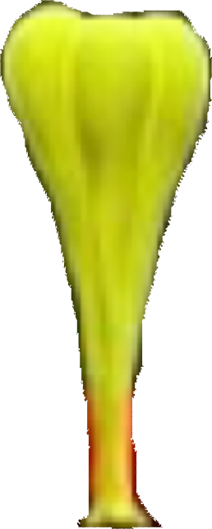
Lateral Flow assay

Slide 12
Lateral Flow assay
Y
Y
Y
Y
Y
Y
Y
Y
Y
Gold nanoparticles decorated with
SARS-COV-2 antibodies dried on the strip
Gold nanoparticles decorated
with control antibodies

Slide 13
Lateral Flow assay
Y
Y
Y
Y
Y
Y
Spike proteins (if present) bind to the antibodies

Slide 14
Lateral Flow assay
Y
Y
Y
Y
Y
Y
Y
Y
TEST LINE
Spike-antibody complex flows to the test line

Slide 15
Lateral Flow assay
Y
Y
Y
Y
Y
Y
Y
Y
TEST LINE
If the spike protein-antibodies complex is formed than it will be captured at the test line
by a second set of antibodies specific to the spike protein and the test line will turn red because
of the presence of gold nanoparticles

Slide 16
Lateral Flow assay
Y
Y
Y
Y
Y
Y
Y
Y
Y
Y
Y
Y
Y
Y
Y
Y
TEST LINE
CONTROL

Slide 17
But why the LFD tests keep working despite the Omicron variant?

Slide 18
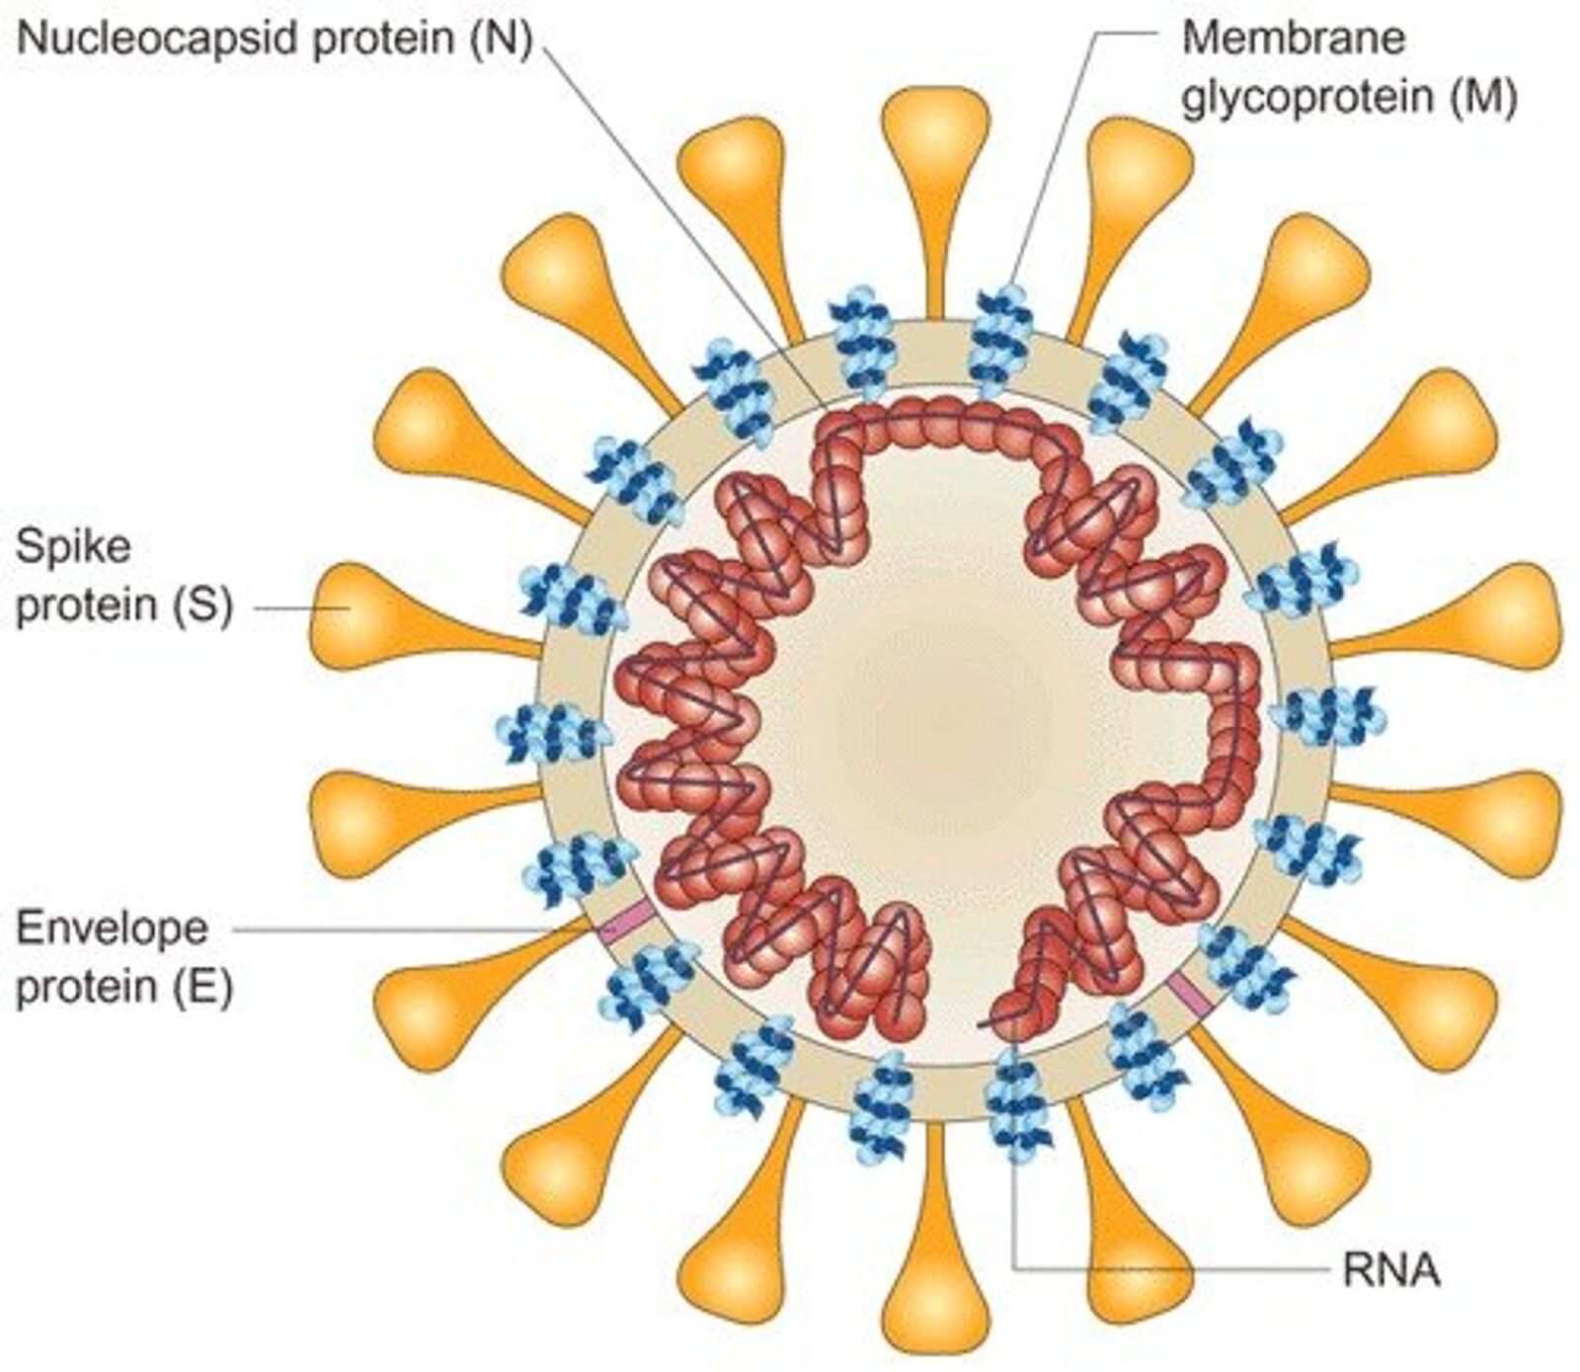
The LFD test target this protein and
NOT the spike protein

Slide 19
Questions?

Slide 20
ELISA
Plastic well
Antigen (=VIRUS) binds
to the surface
Source: A serological assay to detect SARS-CoV-2 seroconversion in humans, MedRxiv

Slide 21
ELISA
Y
Y
Y
Y
Plastic well
Plastic well
Antigen (=VIRUS) binds
to the surface
Antibodies (if present) bind
to the antigen
Source: A serological assay to detect SARS-CoV-2 seroconversion in humans, MedRxiv

Slide 22

ELISA
Y
Y
Y
Y
Y
Y
Read-out
Plastic well
Plastic well
Plastic well
Antigen (=VIRUS) binds
to the surface
Antibodies (if present) bind
to the antigen
Antibodies (if present) bind
to the antigen
Source: A serological assay to detect SARS-CoV-2 seroconversion in humans, MedRxiv

Slide 23
ELISA
Performed in laboratories by trained personnel
Quantitative
Source: A serological assay to detect SARS-CoV-2 seroconversion in humans, MedRxiv

Slide 24
ELISA
Please complete the ELISA virtual lab on Labster

Slide 25
Biosensor
A biosensor is an analytical device that can detect the presence (or absence) of an analyte (often a biological molecule such as a protein which can be indicative of a disease – aka biomarker), in a certain environment (for example in patient blood) using biological molecules as part of the sensing mechanism.
The most important application area of biosensors in medical electronics is in vitro diagnostics (IVD). IVD devices are used in hospitals, clinical laboratories, and to some extent even at GP surgeries.
Also of importance are so called over-the-counter diagnostics, like glucose tests or the LFD covid tests.
Ideally, the sensor should be self-contained, so that it is not necessary to add reagents to the sample to obtain the desired response.

Slide 26
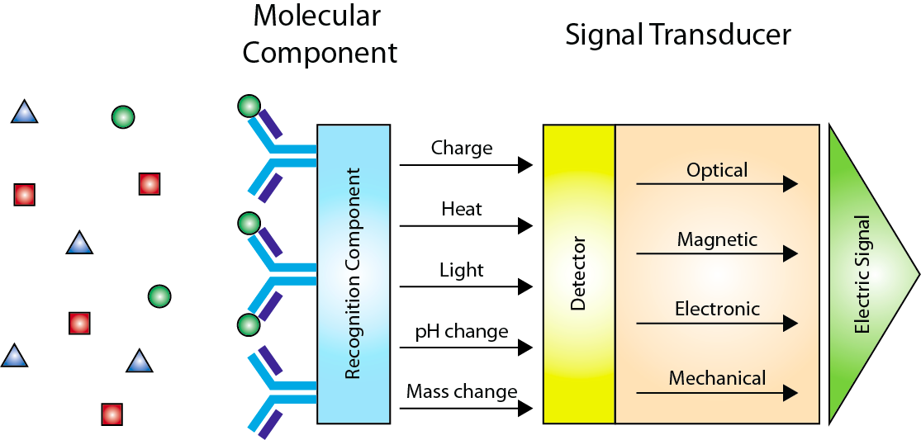
Biosensor

Slide 27
Biosensor

Slide 28
Biosensor (bioreceptor)
A requirement for biosensors is selectivity. Ideally, the sensor only generates a signal if the target-molecule of interest is present (and therefore target molecules bind to the sensor surface, see below), and no signal, even if a large number of very similar molecules are present.
Antibodies are an example of a bioreceptor but there many others.

Slide 29
Biosensor (signal transducer)

Slide 30
Biosensor (signal transducer)
The information of whether or not a biological molecule is present needs to be converted into a processable signal.
The binding of a biological molecule onto the receptor part can generate a change in the sensor environment, e.g. heat, light etc.

Slide 31
Proton-ELISA
How to use an ISFET to detect antigen-antibody interactions
Proton-ELISA: Electrochemical immunoassay on a dual-gated ISFET array, Biosensor & Bioelectronics, 2018

Slide 32
Proton-ELISA
You need to develop/take advantage of biochemical reactions
that release H⁺ (proton) so you can use a ISFET readout
Proton-ELISA: Electrochemical immunoassay on a dual-gated ISFET array, Biosensor & Bioelectronics, 2018

Slide 33
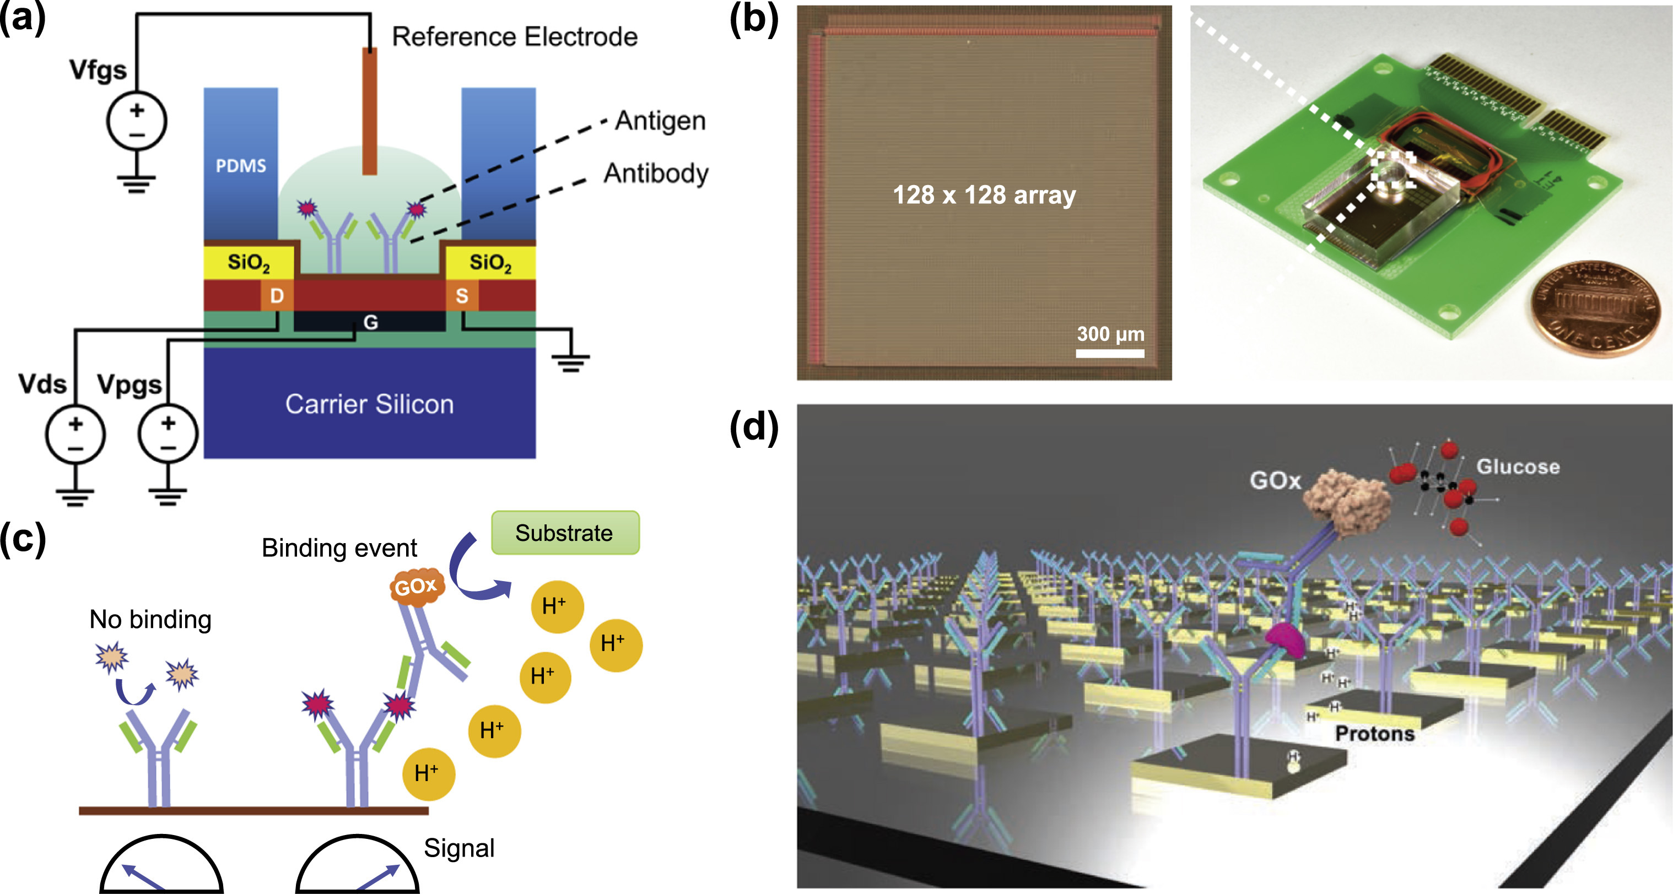
Proton-ELISA
Proton-ELISA: Electrochemical immunoassay on a dual-gated ISFET array, Biosensor & Bioelectronics, 2018

Slide 34
Proton-ELISA
Proton-ELISA: Electrochemical immunoassay on a dual-gated ISFET array, Biosensor & Bioelectronics, 2018

Slide 35
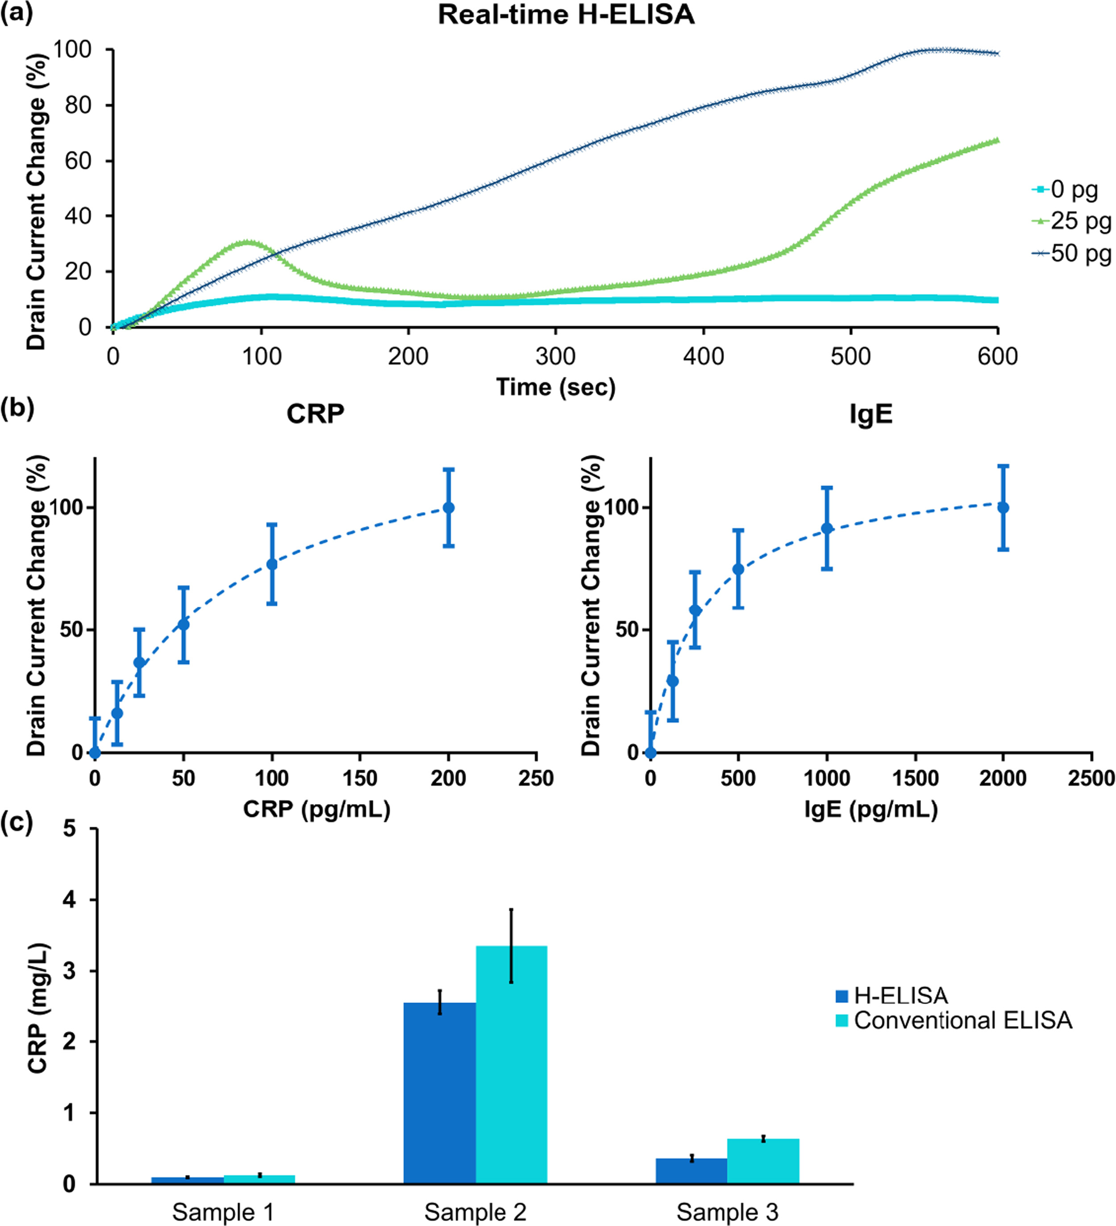
Proton-ELISA
Proton-ELISA: Electrochemical immunoassay on a dual-gated ISFET array, Biosensor & Bioelectronics, 2018

Slide 36
Proton-ELISA (dose response)
analytes
Proton-ELISA: Electrochemical immunoassay on a dual-gated ISFET array, Biosensor & Bioelectronics, 2018

Slide 37
Proton-ELISA (comparison with standard ELISA )
Proton-ELISA: Electrochemical immunoassay on a dual-gated ISFET array, Biosensor & Bioelectronics, 2018

Slide 38
Stab your lecturer
Once in a lifetime opportunity

Slide 40
Electrochemical Sensors
An electronic transducer would be ideal as the interfacing with the rest of the electronics in the patient care pathway would be straight forward.
A biosensor usually has to work in a liquid environment, i.e. the active area is exposed to the liquid sample (e.g. blood or serum).
As a consequence, rather than using pure electronic components, very often electrochemical principles are employed for sensing.
An electrochemical sensor is usually a three -electrode system comprising a working electrode (the actual sensor), a counter electrode (to supply charge/current to the system) and a reference electrode (electrochemical reference).

Slide 41
Electrochemistry
Electrochemistry is the branch of chemistry concerned with the interrelation of electrical and chemical effects. A large part of this field deals with the study of chemical changes caused by the passage of an electric current and the production of electrical energy by chemical reactions. In fact, the field of electrochemistry
encompasses a huge array of different phenomena (e.g., electrophoresis and corrosion), devices (electrochromic displays, electro analytical sensors, batteries, and fuel cells), and technologies (the electroplating of metals and the large-scale
production of aluminium and chlorine).
[Bard and Faulkner, Electrochemical Methods]

Slide 42
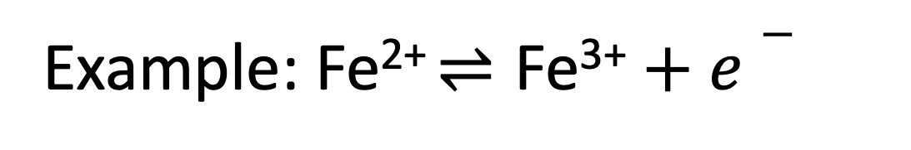
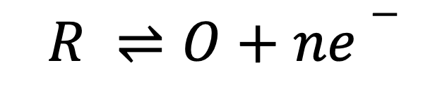
Electrochemistry
ox
$$R ⇌O+ne−$$
red
ox
Example: Fe²⁺$⇌\text{Fe}\text{3}\text{+}+e−$
red

Slide 43
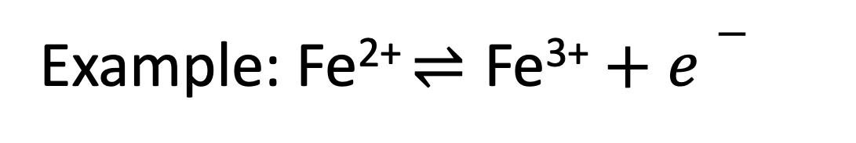
Electrochemistry
Example: Fe²⁺$⇌\text{Fe}\text{3}\text{+}+e−$
LEO the lion says GER
Loss of Electron Oxydation
Gain of Electron Reduction

Slide 44
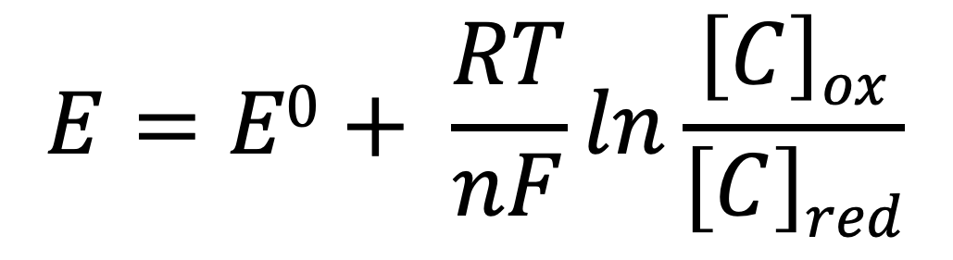
Nernst Equation
For thermodynamically controlled systems, the potential at the
electrode is given by the Nernst equation
$$E=E0+ \frac{RT}{nF}ln\frac{\left[C\right]ox}{\left[C\right]red}$$
E⁰ is the standard potential for the reaction
R is the universal gas constant and is equal to 8.314 J.K⁻¹.mol⁻¹
T is the temperature in Kelvin
n is the number of electrons exchanged in the reaction
F is the Faraday's constant and is equal to 96,485 C mol⁻¹

Slide 45
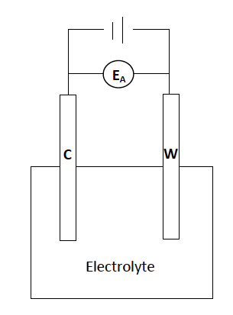
Electrochemical Setup
Note: the rate of the reaction depends on the potential, and the current is proportional to the rate of the reaction.
So in a 2 electrode configuration the potential at the WE is not well defined

Slide 46
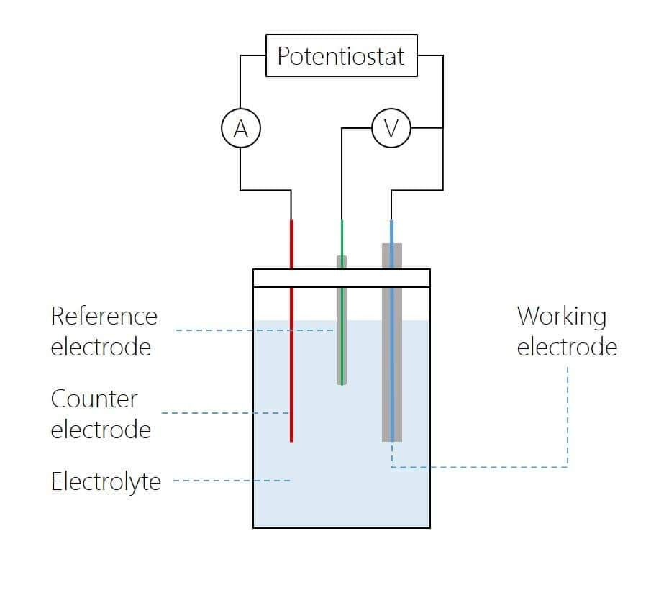
Electrochemical Sensors
An electrochemical sensor is usually a three -electrode system comprising a working electrode (the actual sensor), a counter electrode (to supply charge/current to the system) and a reference electrode (electrochemical reference).

Slide 47
Working Electrode (WE)
This is the sensor and it is usually composed of conductive materials like carbon, Au or Pt.

Slide 48
Reference electrode (RE)
For biological applications: Ag/AgCl (Silver Chloride)
provide a stable potential for controlled regulation of the working electrode potential
made up of phases with essentially constant composition, so RE has a constant potential if no current is passed through it (Nernst equation)
Chemically inert
Stable over a wide range of pH and voltages

Slide 49
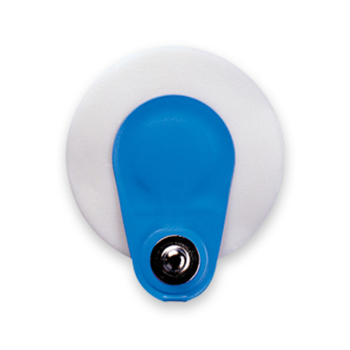
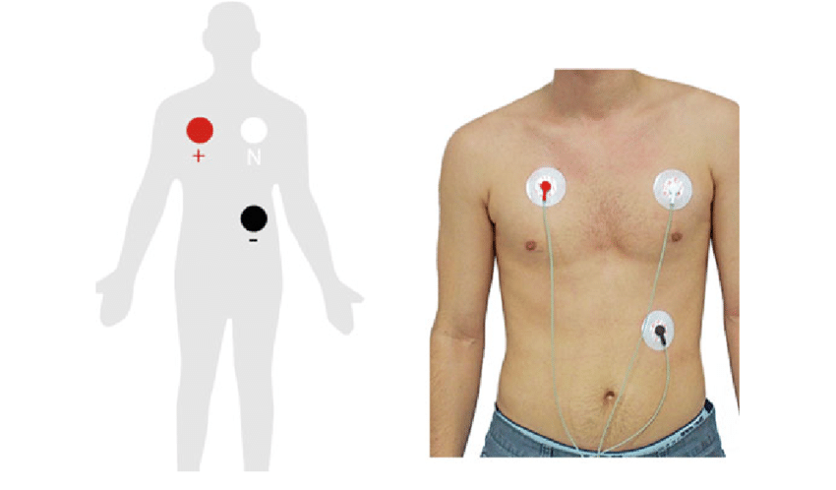
Reference electrode (RE)
ECG electrodes are made of Ag/AgCl (Silver Chloride)
ISFET reference electrodes are made of Ag/AgCl (Silver Chloride)
Electronic glucose meter reference electrodes are made of Ag/AgCl (Silver Chloride)

Slide 50
Counter electrode
The counter electrode is needed to close the circuit and to supply charge/current to the system.
It is usually made of noble metals like Pt or Au

Slide 51
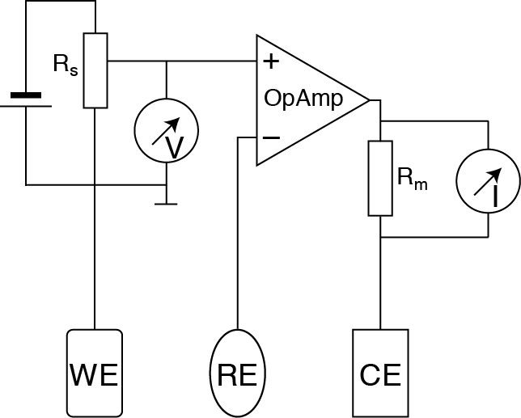
Potentiostat
A potentiostat is the electronic hardware required to control a three electrode cell and run most electrochemical experiments. The system functions by maintaining the potential of the working electrode at a given level with respect to the reference electrode by adjusting the current at the counter electrode.

Slide 52
Potentiostat
For more info about its functioning watch the Video in Minerva under unit1/Potentiostat and read the paper “Lifting the lid on the potentiostat”

Slide 53
Electrochemical Sensors
Various different types of electrochemical transducers are in use.
Amperometric sensors, where electrons are produced/consumed at the working electrode as a result of the analyte-to-capture-molecule binding event. Here , the capture molecule is an enzyme. The most common examples of such sensors are blood glucose sensors;
Potentiometric sensors, where the binding of the analyte causes a shift of the electrochemical potential of the working electrode;
Impedimetric sensors, where the impedance of the working electrode changes as a result of the binding event.

Slide 55
How does it work?

Slide 56
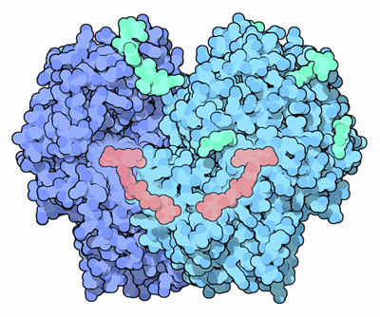
Glucose Oxidase
FAD
(enzyme co-factor)
From PDB101
Notes:
Glucose oxidase is a small, stable enzyme that oxidizes glucose into glucolactone, converting oxygen into hydrogen peroxide in the process. Its normal biological function appears to be centered on the peroxide that is formed: hydrogen peroxide is a toxic compound that can be used to kill bacteria. For instance, glucose oxidase is found on the surface of fungi, where it helps protect against bacterial infection, and it is also found in honey, where it acts as a natural preservative.

Slide 57
Glucose Oxidase (Gox)
The first glucose sensors used the following (electro)chemical reaction:
Glucose + Gox-FAD Gluconolactone + Gox-FADH₂
Gox-FADH₂ + O₂ Gox-FAD + H₂O₂
H₂O₂ 2H⁺ + O₂ + 2e⁻

Slide 58
Glucose Oxidase (Gox)
The first glucose sensors used the following (electro)chemical reaction:
Glucose + Gox-FAD Gluconolactone + Gox-FADH₂
Gox-FADH₂ + O₂ Gox-FAD + H₂O₂
H₂O₂ 2H⁺ + O₂ + 2e⁻
Do you see any issues here?

Slide 59
The first glucose sensors used the following (electro)chemical reaction:
Glucose + Gox-FAD Gluconolactone + Gox-FADH₂
Gox-FADH₂ + O₂ Gox-FAD + H₂O₂
H₂O₂ 2H⁺ + O₂ + 2e⁻
H₂O₂ is thus oxidised at the electrode and the current resulting from
the released electron going into the electrode is measured.
This is problematic as H₂O₂ requires an electrochemical potential of
about 0.7 V to be oxidised. Very high! Lots of components in blood
oxidise (and decompose) as well!

Slide 60
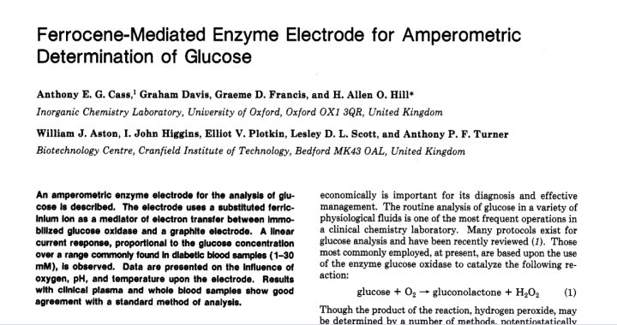
Glucose sensor – improved version
Cass et al, 1984, Anal Chem

Slide 61
Glucose Oxidase (Gox)
Glucose + Gox-FAD Gluconolactone + Gox-FADH₂
Gox-FADH₂ + Ferrocene_{ox} Gox-FAD + Ferrocene_{red}

Slide 62
Glucose Oxidase (Gox)
Glucose + Gox-FAD Gluconolactone + Gox-FADH₂
Gox-FADH₂ + Ferrocene_{ox} Gox-FAD + Ferrocene_{red}
Oxidized at the electrode

Slide 63
Glucose sensor – improved version
Gox-FADH₂ + mediator_{ox} Gox-FAD + mediator_{red}
Mediators
oxidised at electrode
N-methylphenzinium
cation (NMP+)
ferrocene
these can be covalently attached to the enzyme or electrode
Notes:
Process: glucose is oxidised (loses2 e-). FAD acts as the initial e- acceptor and is hence reduced to FADH2 (it takes up 2 H+ to maintain charge neutrality). The mediator (in its oxidised form) then takes up the 2 e- (and is thereby reduced) and hence oxidises FADH2 back to FAD (2 H+ come off as well). The mediator (in its reduced form) then gives up the two e- to the electrode (and is thereby oxidised back to its oxidised form, ready to perform another shuttle reaction).
Therefore, each oxidation of glucose eventually leads to two e- going into the working electrode.

Slide 64
Glucose sensor – improved version
Gox-FADH₂ + mediator_{ox} Gox-FAD + mediator_{red}
Mediators
oxidised at electrode
N-methylphenzinium
cation (NMP+)
ferrocene
these can be covalently attached to the enzyme or electrode
Notes:
Process: glucose is oxidised (loses2 e-). FAD acts as the initial e- acceptor and is hence reduced to FADH2 (it takes up 2 H+ to maintain charge neutrality). The mediator (in its oxidised form) then takes up the 2 e- (and is thereby reduced) and hence oxidises FADH2 back to FAD (2 H+ come off as well). The mediator (in its reduced form) then gives up the two e- to the electrode (and is thereby oxidised back to its oxidised form, ready to perform another shuttle reaction).
Therefore, each oxidation of glucose eventually leads to two e- going into the working electrode.

Slide 65
Glucose sensor – typical setup
silver reference electrode
glucose oxidase
+ mediator
carbon electrode
conducting
tracks
substrate
(ceramic or plastic)

Slide 67
Questions?

